Slide 1


Q-Hack 2024
PwC - Future Model Sustainable Urban Development
April 2024

Slide 2
Case Description
Cologne (or locally 'Kölle'), with a population of 1.1 million people, is the most populous municipality in the state of North Rhine-Westphalia and the fourth largest city in Germany. Cologne is one of the most important locations for the German industry and is home to large production facilities of automotive and pharmaceutical companies such as Ford, Toyota and Lanxess. At the same time, Cologne is the largest education and research location in western Germany with about 104,000 students from numerous different universities. However, the rapid growth and high attractiveness of the city are not only accompanied by positive developments. Purchase prices for condominiums have risen by an average of 44.7 percent¹ over the past five years, the number of registered motor vehicles has grown to 576,139² and the limits for particulate matter and nitrogen oxide are regularly exceeded³.
The city is actively trying to counteract these negative trends and has initiated public consultation on the new development of the Cologne regional plan. Based on the historical urban development, guidelines from politics, general global trends as well as the current budget, a future concept is to be elaborated on how the city can grow sustainably and resiliently.
Students will be asked to consider what measures the county government should pursue to manage the steady growth of people and businesses in an efficient and ecological manner. For example, what might the transportation of people and modes of transportation look like in the future? How will people go about their work? How can Cologne remain attractive as a city for businesses and people from all walks of life? The financing of the measures from budget revenues as well as possible subsidies from the federal government and business cooperations should also be taken into account.
In addition, an ESG-rating concept is to be developed to enable comparability of the sustainability concepts of different cities. This rating is to be based on ESG criteria, i.e. include the dimensions "Environment", "Social" and "Governance". In addition to the environment and social issues, it is therefore also about urban governance, with topics such as equality, efficiency, transparency, accountability, civic participation and security. The ESG rating is intended to make it possible to compare different urban concepts and approaches with one another in order to identify differences and to reflect the impact of the developed and implemented measures.
https://de.statista.com/statistik/daten/studie/554152/umfrage/kaufpreise-fuer-eigentumswohnungen-in-koeln/
https://de.statista.com/statistik/daten/studie/1219689/umfrage/koeln-kraftfahrzeuge/#:~:text=Im%20Jahr%202020%20betrug%20die,der%20zugelassenen%20Fahrzeuge%20j%C3%A4hrlich%20gestiegen.
https://bezreg-koeln.nrw.de/brk_internet/presse/2019/023/index.html

Slide 3
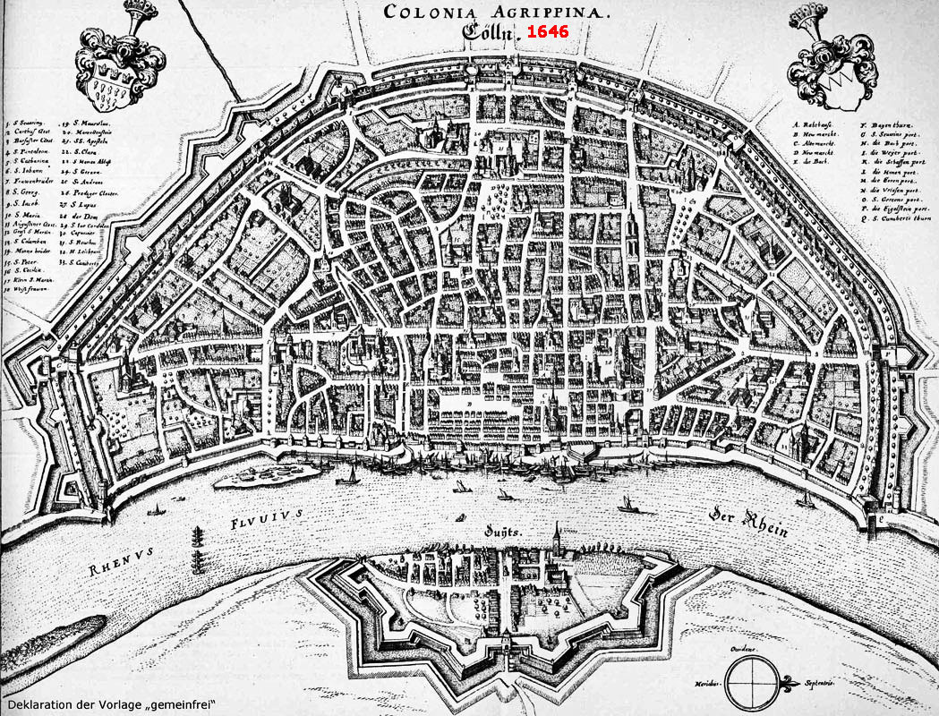
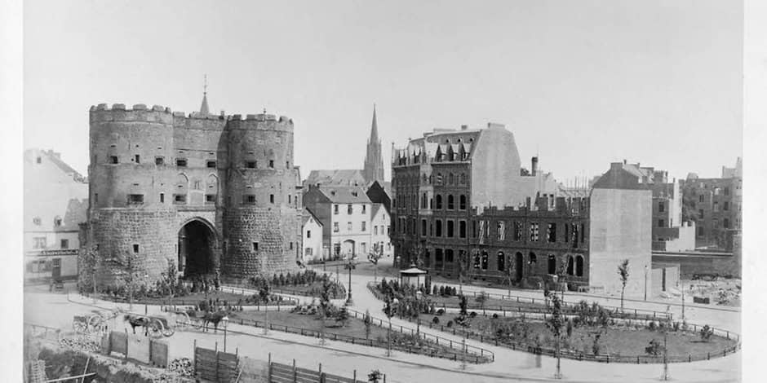
Historical Development
The city of Cologne has developed into a metropolis on the Rhine since its Roman foundation almost 2000 years ago. The city today displays the emblematic Rhine panorama with the Old Town, the Cathedral, the Romanesque church of Great St. Martin and the Hohenzollern Bridge. Other distinctive urban spaces include the area around the cathedral, the inner city belt of the Cologne Rings and the inner green belt. These distinctive spaces give Cologne the format of a major European city; however, they have only emerged since the end of the 18th century¹. From the middle of the 19th century onwards, due to strong population growth, almost all available open spaces within the medieval city walls were exhausted in Cologne. The expansion of the city, which prospered through trade and industry, became more urgent than before, and the city fortifications were increasingly experienced as constricting. The completion of the cathedral in 1880, seen as a national task, provided Cologne with a landmark that is still emblematic today and a prominent point of reference in the city's skyline. Construction work, which had been suspended since the 1530s, was resumed in 1842; the completed cathedral was ceremoniously opened in 1880. By the turn of the century, the cathedral surroundings acquired a decidedly metropolitan character, when the cathedral was exposed on spacious squares. Numerous smaller buildings that had been built up to the cathedral were demolished, giving the cathedral a monumental character on Cathedral Hill.
After the turn of the century, a new urban planning ideal emerged in Cologne, following the "Vision Metropolis". After the end of the First World War, the city fathers endeavored to further develop the ring-shaped city according to the latest findings of spacious, airy and green urban planning. The inner green belt, whose area no longer had to be kept free for military purposes since 1907, offered itself as a development area. In 1919, the newly elected Lord Mayor Konrad Adenauer launched a competition in which the design of Fritz Schumacher prevailed, and he was subsequently commissioned to develop a general settlement plan for the whole of Cologne. In developing it, the city planner was no longer guided by vanishing lines and city parcels, but sought an overarching, spatial approach that was essentially conceived from the landscape areas.
Map of Cologne around 1646²
Picture of the „Hahnentor“ at the end of the 19th century³
https://dewiki.de/Lexikon/Stadtentwicklung_in_K%C3%B6ln#cite_note-1
https://www.guenter-lehnen-koeln.de/Koeln_mittelalt.html
https://www.ksta.de/koeln/historische-stadtmauer-was-vom-mittelalter-in-koeln-uebrig-blieb-23795294?cb=1663659153500&

Slide 4
Historical Development
Cologne was a devastated city after 262 bombing raids at the end of the Second World War; around 80 percent of the city center was considered destroyed. In order to plan the reconstruction prudently, Rudolf Schwarz was appointed general planner from 1946 to 1952¹. His ideas for the "new Cologne" are regarded as a philanthropic and metaphysically based plan that wanted to map out the reconstruction with a sense of proportion and respect for historical heritage.The general planner did not succeed in asserting himself in all matters in the face of conflicting interests. However, he was able to preserve the traditional urban layout structure, among other things by not routing the major thoroughfares through the neighborhood centers, but rather by understanding them as boundaries between the Veedeln (neighborhoods). In addition, Schwarz succeeded in maintaining a relatively high proportion of housing within the city center and in continuing to develop the idea of the green banks of the Rhine.
From the 1960s onwards, car traffic was gradually pushed out of the city center: Schildergasse (1965) and Hohe Straße (1967), both of which are now among the busiest shopping streets in Germany, became the first sections of the pedestrian zone. In recent decades, Cologne's cityscape has received significant impetus from the development of the former freight station area with the Mediapark, from the development in Deutz (including the construction of the Kölnarena, now know as Lanxess arena), and from the transformation of the Rheinauhafen into a modern, mixed-use urban district. The construction of the district known as Mediapark on the site of the former Gereon freight station not far from the Rhine was considered the largest urban development project in Cologne at the end of the 20th century.
At the turn of the millennium, extensive plans were drawn up to give Deutz (a district of Cologne), which lies opposite the historic old town, its own, self-confident urban appearance. Starting with the newly established Deutz ICE train station and the trade fair grounds, the considerations sought to form a trade and logistics center in Deutz that would position itself as a modernist business location with a number of high-rise buildings. Its planning image was deliberately inspired by the “La Défense” district of Paris. In fact, further development of the "trade and logistics center" was delayed: Five high-rise buildings were planned in the vicinity of the ICE station, which were to define a skyline of their own in the soft landscape of Deutz. These towers, however, were stopped by the objection of UNESCO, which saw the visual impact of the cathedral impaired and therefore threatened to deny it the status of a World Heritage Site. The Rheinauhafen, which was redeveloped from 2001 to 2013, is considered Cologne's most recent "gem of urban development.“. After the logistical importance of the port near the old city had steadily declined over the course of the 1960s, the city decided to repurpose the site. A sophisticated urban space with green and open spaces was to be created on the area, which stretched for about two kilometers along the Rhine and was built up with warehouses and silos. To this end, the city invited entries to an urban planning competition in 1991, as a result of which the idea proposed by the prize-winner Teherani to add three so-called "crane houses" to Cologne's urban panorama up the Rhine prevailed. The remaining buildings were arranged in a more linear fashion and parallel to the Rhine, whereby the existing listed buildings were integrated into the planning.
https://dewiki.de/Lexikon/Stadtentwicklung_in_K%C3%B6ln#cite_note-1

Slide 5
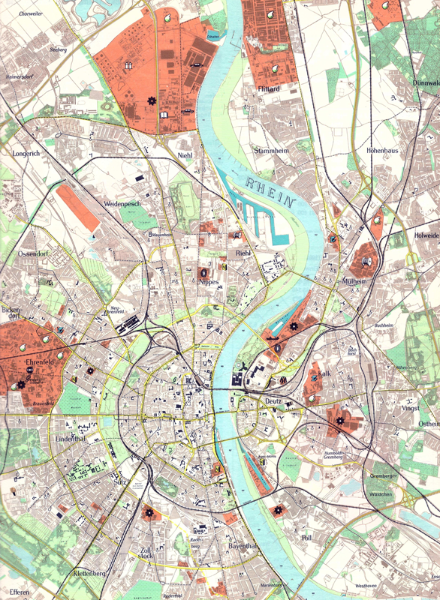
Main industry hubs
The main sectors of industrial development in Cologne were: Metal processing, mechanical engineering, chemicals, and engine and vehicle manufacturing¹. A few companies are shown here as examples, which are also strikingly and vividly visible in the cityscape through distinctive and industrial architecture.
Cologne
https://www.rheinische-industriekultur.com/seiten/objekte/orte/koeln/einfuehrung_industriekultur_koeln.html

Slide 6
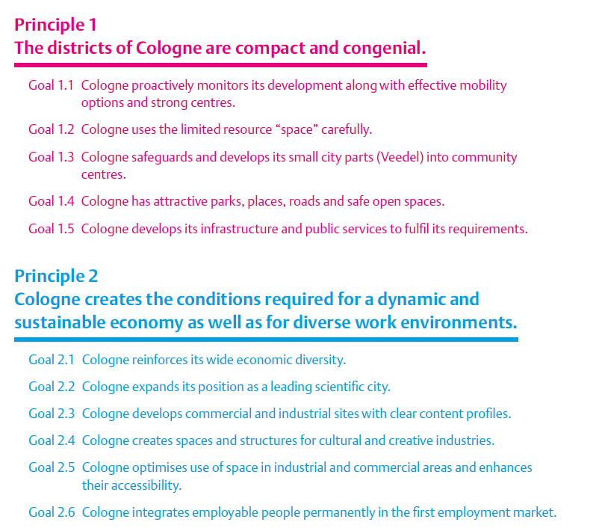
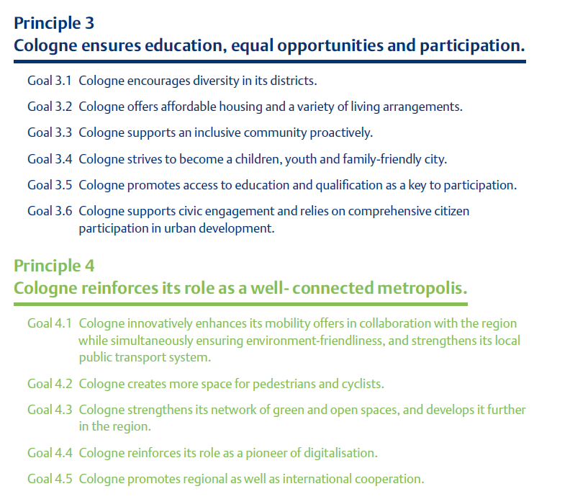
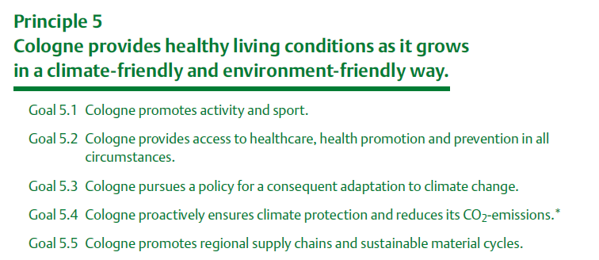
2030+ Plan of the county government
With the help of a framework of goals, the city can orientate itself to a strategic framework that will guide its future action. The framework of goals consists of five principles and 27 goals¹.
https://www.stadt-koeln.de/politik-und-verwaltung/stadtentwicklung/koelner-perspektiven-2030/index.html

Slide 7
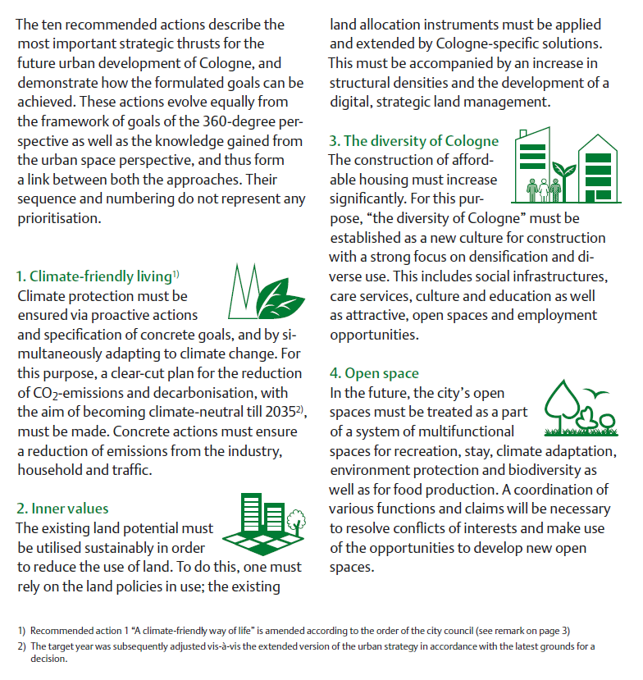
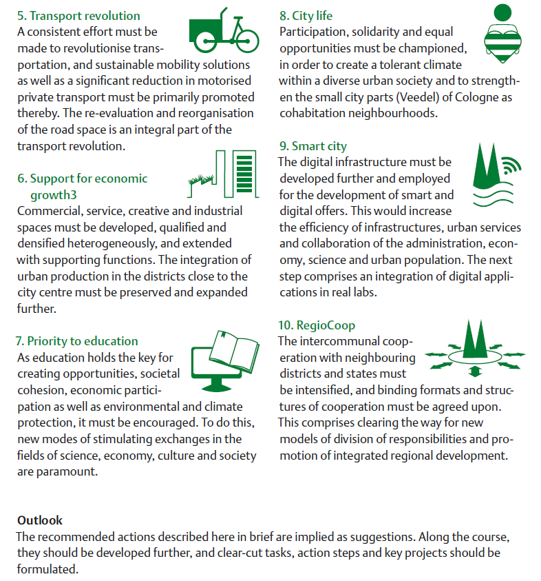
2030+ Plan of the county government

Slide 8
Budget Plan 2023
Product area | Distribution of expenses of all product areas |  | Distribution of revenues of all product areas |  | Result of the product areas
 | In € | In % | In € | In % | In €
Internal Management | 549.626.775 | 9,66 | 106.430.888 | 1,87 | -443.195.887
Security and Order | 382.920.349 | 6,73 | 206.300.278 | 3,62 | -176.620.071
School authority functions | 509.338.226 | 8,95 | 157.470.599 | 2,77 | -351.867.626
Culture and Science | 280.083.848 | 4,92 | 32.318.658 | 0,57 | -247.765.191
Social assistance | 1.272.337.738 | 22,36 | 823.841.573 | 14,47 | -448.496.165
Child, youth and family services | 1.097.249.616 | 19,29 | 473.771.434 | 8,32 | -623.478.182
Health services | 66.427.329 | 1,17 | 7.388.046 | 0,13 | -59.039.283
Sports promotion | 40.924.725 | 0,72 | 5.867.972 | 0,10 | -35.056.754
Spatial Planning and Development | 52.347.431 | 0,92 | 7.009.025 | 0,12 | -45.338.407
Construction and Housing | 258.572.833 | 4,54 | 151.814.834 | 2,67 | -106.758.000
Utilities and Waste Management | 14.308.210 | 0,25 | 92.937.188 | 1,63 | 78.628.978
Transport areas and facilities, public transport | 334.827.179 | 5,89 | 135.670.625 | 2,38 | -199.156.554
Nature and landscape conservation | 105.067.703 | 1,85 | 25.506.243 | 0,45 | -79.561.460
Environmental protection | 26.252.136 | 0,46 | 1.815.138 | 0,03 | -24.436.997
Economy and tourism | 44.390.612 | 0,78 | 49.077.353 | 0,86 | 4.686.741
General financial management | 650.587.510 | 11,44 | 3.408.151.546 | 59,87 | 2.757.564.036
Foundations | 4.158.816 | 0,07 | 6.930.000 | 0,12 | 2.771.184
District-oriented funds | 0 | 0,00 | 0 | 0,00 | 0
https://www.stadt-koeln.de/politik-und-verwaltung/finanzen/stadthaushalt

Slide 9
Budget Plan 2024
Product area | Distribution of expenses of all product areas |  | Distribution of revenues of all product areas |  | Result of the product areas
 | In € | In % | In € | In % | In €
Internal Management | 574.989.659 | 9,72 | 102.452.228 | 1,82 | -472.537.431
Security and Order | 392.657.710 | 6,64 | 210.522.664 | 3,74 | -182.135.046
School authority functions | 536.962.320 | 9,07 | 153.181.115 | 2,72 | -383.781.204
Culture and Science | 296.554.019 | 5,01 | 32.060.272 | 0,57 | -264.493.748
Social assistance | 1.286.917.101 | 21,75 | 776.886.239 | 13,79 | -510.030.862
Child, youth and family services | 1.124.121.381 | 19,00 | 483.263.454 | 8,58 | -640.857.927
Health services | 68.119.856 | 1,15 | 7.388.046 | 0,13 | -60.731.810
Sports promotion | 46.049.540 | 0,78 | 4.799.492 | 0,09 | -41.250.048
Spatial Planning and Development | 48.475.455 | 0,82 | 4.061.275 | 0,07 | -44.414.181
Construction and Housing | 264.363.208 | 4,47 | 138.455.731 | 2,46 | -125.907.477
Utilities and Waste Management | 13.879.952 | 0,23 | 91.056.464 | 1,62 | 77.176.513
Transport areas and facilities, public transport | 355.565.302 | 6,01 | 135.151.306 | 2,40 | -220.413.996
Nature and landscape conservation | 109.591.727 | 1,85 | 26.211.090 | 0,47 | -83.380.637
Environmental protection | 26.544.714 | 0,45 | 1.813.371 | 0,03 | -24.731.343
Economy and tourism | 48.059.109 | 0,81 | 61.652.739 | 1,09 | 13.593.630
General financial management | 720.705.836 | 12,18 | 3.395.799.847 | 60,30 | 2.675.094.011
Foundations | 4.153.855 | 0,07 | 6.930.000 | 0,12 | 2.776.145
District-oriented funds | 0 | 0,00 | 0 | 0,00 | 0
https://www.stadt-koeln.de/politik-und-verwaltung/finanzen/stadthaushalt

Slide 10
Budget Plan 2023/2024
Friday, November 10, 2022, the Council of the City of Cologne adopted the 2023/2024 budget, including the medium-term financial planning up to 2027. Subject to the necessary approval of the district government, the city will also succeed in starting next year with a resolved budget¹. This is not a matter of course, given the many special circumstances that have characterized the previous years and will continuously affect the following. The aftereffect of the Corona pandemic, the increasing energy costs and the war in Ukraine have shaped the drafting process. The approved biennial budget outlines expenditures totaling 5.69 billion euros in 2023 and 5.9 billion euros in 2024 (2022: 5.28 billion euros). In 2023, total revenues amount to 5.69 billion euros, and in 2024 to 5.63 billion euros (2022: 5.05 billion euros). This results in a slight planned budget surplus of 2.88 million euros in 2023, achieving budgetary balance; however, in 2024, the budget closes with a significant deficit of 286.0 million euros.
However, as City Treasurer Prof. Dr. Dörte Diemert warned in her speech at the launch of the city budget, these are figures on paper that do not reflect the actual situation. Around fifty percent of the income is dependent on the economic situation. Looking to the future, Diemert sums up:
“Without the disruptions caused by the pandemic and the Ukraine war, our budget would be balanced next year. The numbers thus show how strongly our budget is shaped by current challenges and that we manage our finances solidly in the crisis. However, ahead of us lies no easy time, and we cannot know all developments and risks. Therefore, the clear message: We continue to act appropriately. We remain capable of action, and we react - if necessary - flexibly!”
Mayor Henriette Reker is convinced that the presented budget is future-oriented:
“Thanks to joint efforts, we have succeeded in creating the earliest possible planning security for all stakeholders in this city with the budget approved today. With this budget, we are driving forward urban transformation and keeping our Cologne qualities such as social cohesion, solidarity, and humanity firmly in focus! ”
https://www.stadt-koeln.de/politik-und-verwaltung/presseservice/planungssicherheit-schwierigen-zeiten

Slide 11
Political Guidelines
Livable cities include good jobs, sustainable infrastructure and mobility, and people's health and participation¹. Livable rural areas and villages with good jobs and infrastructure dampen the urge to move to the cities. The German government and the international community are committed to this. More than half of the world's population, and in Germany as many as three out of four, live in cities. It is forecast that by 2050, around 66 to 75 percent of the world's population will live in cities. This will lead to considerable challenges - across all countries. For example, in the area of the environment and energy. Although life in cities can be made more efficient than in rural areas, cities currently consume up to 75 percent of the energy generated worldwide. At the same time, they generate around 80 percent of global gross domestic product. This means they are responsible for up to 80 percent of mankind's energy-related CO2 emissions. The future of cities will be crucial for environmentally sound development and combating climate change. People's mobility and their access to affordable housing are also crucial to quality of life and thus major challenges for urban development policy. But the inclusive city must also offer people the best access to education and health care.
The 2030 Agenda, which the global community agreed on in New York in 2015, contains important answers to these challenges. With the global sustainability goal 11, the states commit themselves for the first time to sustainable, inclusive urban development worldwide! This global goal was concretized by the New Urban Agenda (2016). Sustainable and integrated urban development is at the heart of government policy: in 2007, the "Leipzig Charter" laid the foundation for a new urban development policy in Europe. The joint initiative of the federal, state and local governments "National Urban Development Policy" serves the national implementation of the goals and principles of the "Leipzig Charter". Integrated urban development policy is also an important pillar of the German government's high-tech strategy. As early as 2012, it defined the future project of the "CO2-neutral, climate-adapted and energy-efficient city" and developed a "Research and Innovation Agenda for the City of the Future" (FINA) from this in the "National Platform for the City of the Future" together with municipalities, science, business and civil society. In 2016, the German government's "Future City Innovation Platform" was founded with the aim of implementing this agenda and promoting the exchange of good solutions and their transfer into municipal practice. Equally important is rural development to ensure equal living conditions in cities and rural areas. This includes providing good services, promoting local initiatives and civic engagement, and overcoming the digital divide between urban and rural regions. Urban and spatial development is also one of the fields of action of German European and development policy.
https://www.bundesregierung.de/breg-en/issues/sustainability

Slide 12
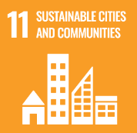
Political Guidelines
The German Sustainability Strategy is Germany's contribution to the implementation of the 2030 Agenda¹. It sets the framework for sustainable action by politics and society. At its heart is a sustainability management system that specifies targets with concrete timeframes for fulfilment and indicators for continuous monitoring.
Which indicators show sustainable and integrated urban development?
Land use: Reduce the use of additional land for settlement and transport purposes to less than 30 hectares per day by 2030. In addition, the loss of open space should be reduced. The settlement density is not to be reduced in the process.
Mobility: Final energy consumption in goods and passenger transport is to be reduced by 15 to 20 percent by 2030, and the rapid accessibility of centres by public transport is to be improved.
Affordable housing for all: the share of the population overburdened by housing costs should decrease to 13 percent.
The overall aim is to make cities inclusive, safe, resilient and sustainable. Specifically, this includes, among other things:
Sustainable use of land
Safe, affordable and sustainable urban and rural mobility
Reducing the environmental impact of cities
Securing basic services and digital connectivity for rural communities
Affordable housing for all
In September 2018, the Federal Government, together with the municipalities, agreed on a housing offensive. The agreed package of measures includes investment impulses, measures to ensure the affordability of housing, to reduce construction costs and to secure skilled labour. The goal is to build 1.5 million new dwellings in this legislative period. The Federal Government is making more than 13 billion euros available in this legislative period for social housing construction, the Building Children's Allowance, housing subsidies and urban development promotion alone, which is continuing at a record level.
https://www.bundesregierung.de/breg-en/issues/sustainability

Slide 13
Political Guidelines
Good air quality is crucial for the future viability of cities and the quality of life of people¹. The Federal Government is working at many levels to improve air quality in Germany. The air in German cities and municipalities is getting better and better. In 2020, only very few municipalities still exceeded the permissible nitrogen dioxide limits. While in 2016 90 cities and municipalities were still above the permissible limit of 40 micrograms of nitrogen dioxide (NO2)/m3, according to a preliminary evaluation (as of February 2021) there were fewer than ten in 2020. This development was promoted by the emergency program "Clean Air 2017 - 2020", which was launched by the federal government in 2017 and concluded in 2020. Since 2017, the Federal Government has successfully supported municipalities with particularly high nitrogen dioxide (NO2) pollution in the design of sustainable and low-emission mobility with a total of 1.5 billion euros, with the aim of demonstrably and permanently complying with the specified NO2 limits everywhere in Germany. The program builds on already existing support program. The measures of the immediate program include the digitalization of municipal transport systems, the electrification of taxis, rental cars, car-sharing vehicles and bus fleets in local public transport, as well as the promotion of charging infrastructure. In addition, cycling is to be promoted. More and more cars are on the roads - also because Germany is a transit country. This has an impact on the climate balance. One answer to this is more electromobility, as it is the key to climate-friendly mobility worldwide. In the course of 2021, around 356,000 more passenger cars with purely electric drives were newly registered than ever before.
The operation of electric vehicles produces significantly less CO2, especially in combination with regeneratively generated electricity. In addition, electric vehicles with their energy storage systems can compensate for fluctuations in wind and solar power in the future and thus support the expansion and market integration of these unsteady energy sources.
Another important aspect for an efficient and sustainable design of transport is the strengthening of local public transport. The quality of life in our cities and in the countryside is directly linked to the quality of public transport. Public transport not only has advantages in terms of land use, but also a clear environmental advantage: trams, suburban trains and underground trains, as well as local buses and trains, emit on average less air pollutants and CO2 per passenger kilometer than a passenger car. Measures to develop user-friendly, cross-modal transport information systems and the demand-oriented use of automated vehicles in urban and rail transport contribute to increasing the attractiveness of local public transport. In addition, the Federal Government supports municipalities in the digitalization of urban transport systems. For example, it promotes the networking of transport modes (e.g. measures to improve the networking of all means of transport) and the comprehensive provision of environmental, mobility and traffic data (e.g. measures to digitalize traffic management through the use of mobility data).
https://www.bundesregierung.de/breg-en/issues/sustainability

Slide 14
Number of German cities exceeding the legal limit for nitrogen dioxide per cubic meter of air from 2016 to 2022
https://de.statista.com/statistik/daten/studie/1017347/umfrage/anzahl-der-staedte-mit-grenzueberschreitendem-stickstoffdioxidwert-in-deutschland/

Slide 15
The 15 German cities with the highest NO₂ limit exceedances in 2017¹
Current NO₂ limit for German cities
https://www.greencity.de/pressekonferenz-zum-thema-luftverschmutzung-in-muenchen-und-des-klageprozesses-der-duh-zum-stadtrat/

Slide 16
Development of asking prices for condominiums in Cologne from 2012 to the 4th quarter of 2023¹
https://de.statista.com/statistik/daten/studie/554152/umfrage/kaufpreise-fuer-eigentumswohnungen-in-koeln/

Slide 17
Number of motor vehicles in Cologne in the years 2010 to 2022
https://de.statista.com/statistik/daten/studie/1219689/umfrage/koeln-kraftfahrzeuge/

Slide 18
Development of the population in Cologne (independent city) from 1995 to 2022¹
https://de.statista.com/statistik/daten/studie/322477/umfrage/entwicklung-der-gesamtbevoelkerung-in-koeln/

Slide 19

Sustainability and Sustainable Finance Sustainability encompasses the three pillars Environmental (E), Social (S), and Governance (G)
Sustainability risks (“ESG”)
Environment
Social
Working conditions
Diversity
Social commitment
etc.
Governance
Anti-corruption
Compliance
Data protection
etc.
Climate risks
Other risks
Bio-diversity
Water quality
Waste
etc.
ESG
Physical risks
Transition risks
Technological changes
Political, regulatory and legal changes
Changing market sentiment and stakeholders
Reputational and legal risks
etc.
Acute risks
Heat
Floods
Hurricanes
Wildfires
etc.
Chronic risks
Temperature rise
Precipitation
Agricultural productivity
Sea level rise
etc.
What is Sustainable Finance?
Sustainable finance, or sustainability in the financial system, refers to the process of appropriately considering environmental, social and governance (ESG) aspects in investment decisions in the financial sector, leading to increased longer-term investment in sustainable economic activities and projects.

Slide 20
ESG Factors and typical structure/design of an ESG rating model
Environmental factors | Social factors | Governance factors | Typical structure/design of an ESG Rating Model
Environmental factors are related to the quality and functioning of the natural environment and systems, which may have an impact on the activities within the project. The main transmission channels for the impact of environmental factors cover Physical (extreme weather events and gradually deteriorating conditions in climate); Transition (regulatory restrictions & taxation, disruptive technologies) transmission channels. | Social factors are related to the rights, well being and interests of people and communities, which may have an impact on the activities of the institutions’ counterparties. | Governance factors cover governance practices, including the inclusion of ESG factors in policies & procedures under the governance of the counterparties.
Examples of Environmental Factors Greenhouse Gas (GHG) emissions and other air pollutants Water use, consumption and management Use of ecosystems – impact and dependence. Need for protection of biodiversity. Climate change Production and management of waste Innovation in environment-friendly products and services | Examples of Social Factors Labour conventions and workforce consideration Human rights, diversity and equal opportunity Customer privacy and personal data security. | Examples of Governance Factors Code of conduct and set of business principles Anti-corruption and anti-bribery policies Board diversity, structure and transparency | For each pillar, criteria and defining indicators (i.e., data sets) are defined and collected, in order to compute an adequate ESG-Score.
Total
ESG
ESG risks mean the risks of any negative impact to the project stemming from the current or prospective impacts of ESG factors on the latter.
Dimension
E
S
G
Criteria
E1
E2
Indicators
E1.1
E1.2
!
Do not pick to many criteria and indicators! Time is limited!

Slide 21
Main Modelling steps
!
Focus on steps 01 - 04!
Main modelling steps
Focus
 |  | Process | Outcome
01 | Identification of potential risk factors | The concept includes theoretical aspects for estimation of ESG ratings | ESG modelling concept
02 | Data Collection | Collection of relevant factors including codes for automatic construction of a development sample | Long list of ESG factors
03 | Univariate Analysis | Selection of ESG factors in the short list, based on expert judgement | Short list of ESG factors
04 | Multivariate Analysis | Joint analysis of ESG factors from the short list and selection of a final model setup | Final Model
05 | Assessment | Finding out the key factors driven by the external rating | Analyses results Key conclusions how the main factor sets look like
Identification of relevant ESG risks which are relevant for the evaluation of the measures taken. The collection of the relevant risk factors is usually a mix of externally available information and “in-house” data.

Slide 22






Potential Data Sources for the ESG-Rating
Some ideas for your research – feel free to be creative!

